Slide 1
Web-Based Campus Navigation Application for Babcock University
By
JIMO AHMED OLALEKAN 22/0416
OBIH JOAN CHIDINMA 22/2610
ODUKOYA ENIOLA AYOOLUWA 22/2221
SUPERVISED BY
Prof. Eze M.O.

Slide 2
Introduction
Problem
· Difficult Campus Navigation
· Large, complex campus layout
· Challenging for new students & visitors
· Ineffective Current Solutions
· Static paper maps
· Generic digital maps (e.g., Google Maps)
· Lack campus-specific context & real-time updates
Our Solution
· Web-based (no installation required)
· Interactive campus maps
· Real-time routing and directions
· Searchable building directory
· Mobile-responsive design
· Live location tracking
Consequences
· Delays & missed appointments
· User frustration

Slide 3
Problem Statement
The core problem is the absence of a dedicated, context-aware navigation system for Babcock University, leading to:
Difficulty
in
Navigation
Ineffective
Existing
Tools
Negative
Impact
Productivity
Loss

Slide 4
Research Motivation
· Address real navigation pain points for new students and visitors
· Support Babcock's smart campus initiatives
· Enhance overall university experience and technological image

Slide 5
Aim and Objectives
Aim:
· To design and develop a web-based digital campus navigation system for Babcock University that provides an efficient, interactive, and context-aware method of locating key facilities.
Specific Objectives:
1. To evaluate the limitations of existing campus navigation systems.
2. To design and develop a web-based system using HTML, CSS and JavaScript.
3. To integrate geolocation and searchable campus directories.

Slide 6
Significance and Benefits
Students
Visitors
University
Administrative
Impact Areas
Reduced stress,
better time management
Improved first impression
Enhanced technological reputation
Reduced direction-giving interruptions

Slide 7
In carrying out the literature review, this study ensured the use of credible and published articles obtained from the following sources:
Google Scholar
IEEE Xplore
15 Articles
10 Articles
Literature Review
ResearchGate
Online Documentation
12 Articles
13 Articles
Total Number of Literature Sources Reviewed: 50

Slide 8
Summary of Key Insights from Literature:
Web Technologies | HTML, CSS, JavaScript
Navigation Systems | Generic digital maps (Google Maps) are insufficient for campus-specific wayfinding.
Web-Based Mapping | APIs like Google Maps API and Leaflet.js enable the creation of custom, embeddable interactive maps.
Campus Applications | Dedicated campus systems improve orientation and reduce reliance on human assistance.
NAVILOC (Covenant University) | A 3D visualization system but lacked web-based interactivity and mobile responsiveness.
Federal University of Technology, Minna | Focused on offline GIS mapping but lacked real-time navigation and web integration.
Our study addresses these gaps by developing a responsive, web-based system with real-time navigation features.

Slide 9
System Design and Methodology
Development
Approach
System Architecture
Technology Stack
· Methodology: Bottom-Up & Agile
· Focus: Incremental development, continuous testing, and user feedback.
· Presentation Layer: Frontend (HTML, CSS, JS)
· Application Layer: Business Logic & APIs
· Data Layer: Database & Storage
· Frontend: HTML5, CSS3, JavaScript
· Mapping: Google Maps API
· Backend & Data: Node.js / Firebase, JSON

Slide 10
Key Features
01
02
03
04
05
06
Real-time Routing
Interactive Map
Smart Search
ETA Calculation
Responsive Design
Location Tracking

Slide 11
Implementation Plan
Phases:
Requirements Analysis
System Design
Development
Testing
Deployment

Slide 12
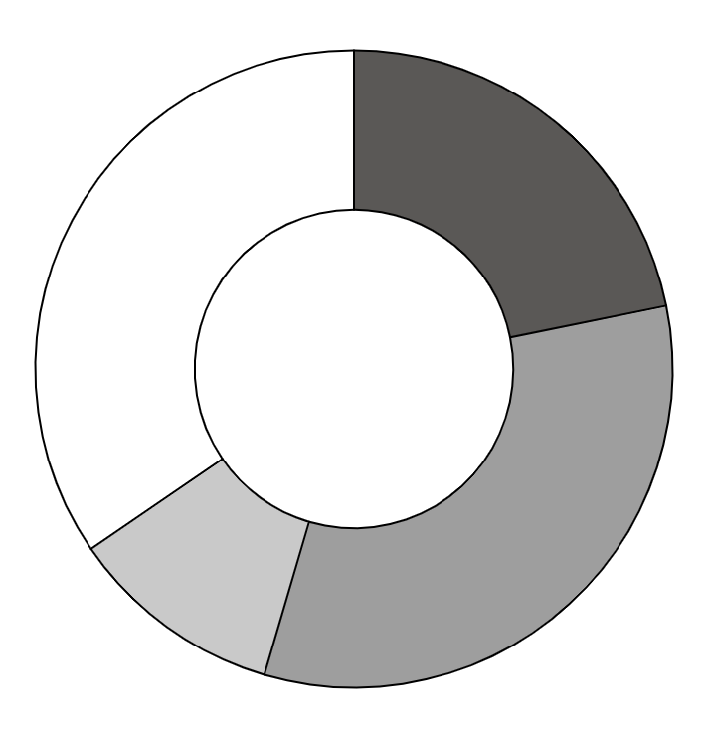
Expected Outcomes
Improved navigation efficiency
Reduced time spent finding locations
Scalable platform for future enhancements
Positive user feedback
Success
Metrics

Slide 13
Testing Strategy
Unit Testing
Integration Testing
User Acceptance Testing
Performance Testing
Quality Assurance Focus:
Individual Components
System workflow
Real Users
Load Times

Slide 14
Thank You
Project Team Members
JIMO AHMED OLALEKAN 22/0416
OBIH JOAN CHIDINMA 22/2610
ODUKOYA ENIOLA AYOOLUWA 22/2221
Department of Computer Science
Babcock University

